Slide 1

Differentiation and Integration
- Ins, outs and a little extra

Slide 2



Plan for today
Usage of differentiation and integration in cognitive science
Basic interpretation
“Advanced” differentiation
“Advanced” Integration
Exercises.

Slide 3




Cognitive science:
Why is it relevant for us?
Several analysis parameters is based on integrals and derivatives.
A lot of machine learning algorithms optimizers uses derivatives.
Computational models of cognition and behavior, neat to know differential equations.

Slide 4
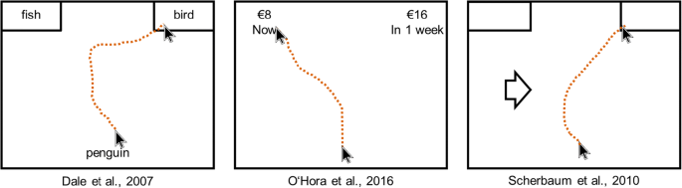

Eye- & Mouse-Tracking.
A measure for tracking “continuous” and real-time cognition.
We log coordinates (x,y).
Having a vector function of (x,y) given (t) time. $\overset{⃑}{s}$(t)
First derivative of such function will give us velocity. (how fast is the cursor moving in a direction).
Second derivative Acceleration.
Gives us a measure of “certainty”.

Slide 5
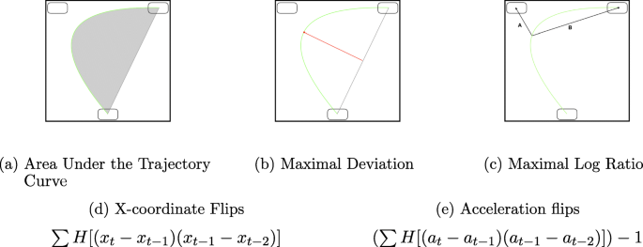
Eye- & Mouse-Tracking.
Typical measures in mouse-tracking.
Area Under the Trajectory (AUC).
Maximum deviation.
X-coordinate flips can be found using direction of our velocity vector.

Slide 6

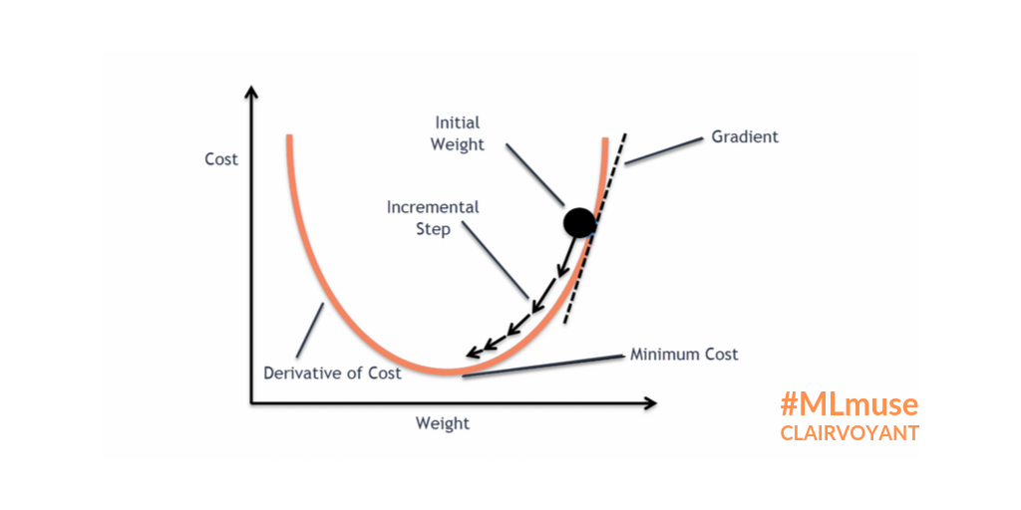
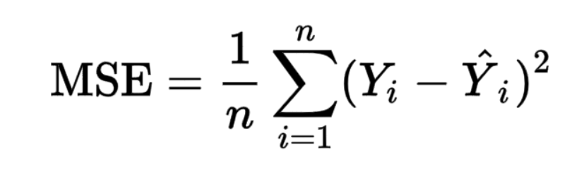
Machine Learning.
Remember that regression could be though of as:
We find the Beta vector that minimize a loss function.
There exist many different optimizers (algorithms for finding the argmin or argmax)
Different iterations of gradient decent is a data- scientists first friend.

Slide 7
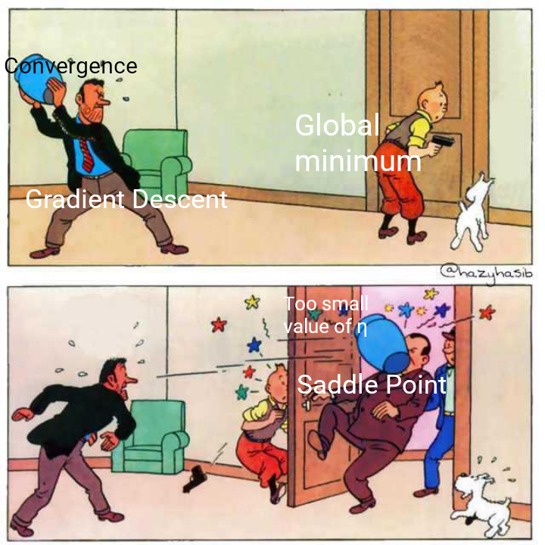
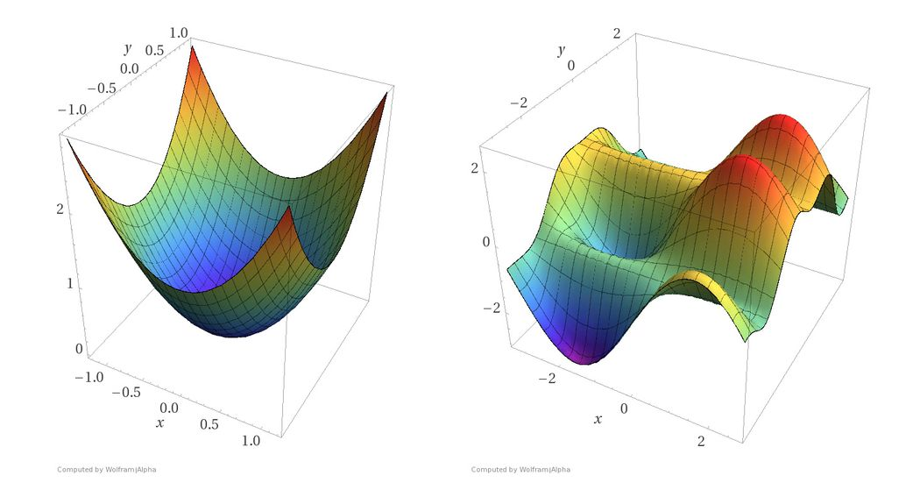
Might get stuck.

Slide 8
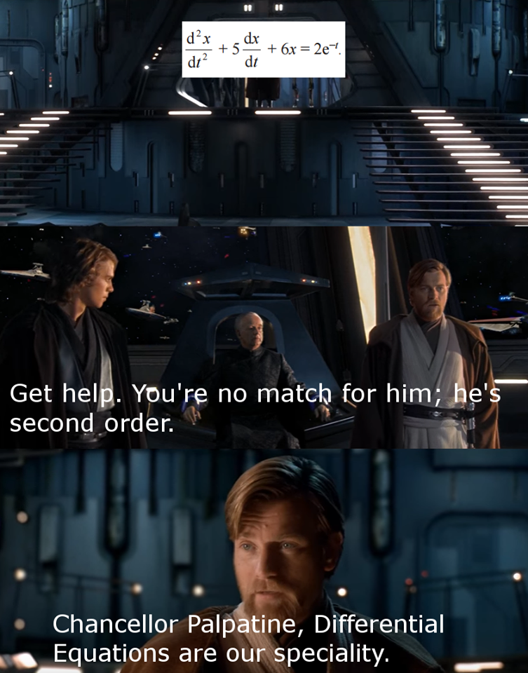
Differential equations:
You’ll get there!
Elections or Jedi-Master Level.

Slide 9
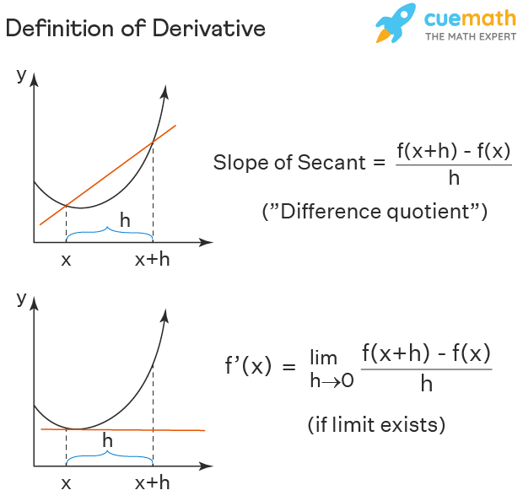
Derivatives:
Nice illustration
Derivative of order n
First Derivative
SPEED!!
Does the function grow.
How fast does the function grow.
In what direction does it grow.
Second Derivative
Speed of Speed (acceleration).
How fast does the speed change.
In what direction does the speed change.

Slide 10
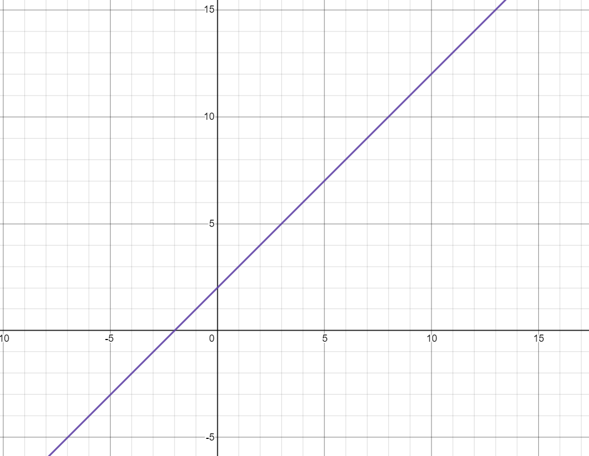
Quiz time:
f(x)
Find f(x) and f’(x) and f’’(x) if present.
- Velocity is constant in a linear function.
f’(x)

Slide 11
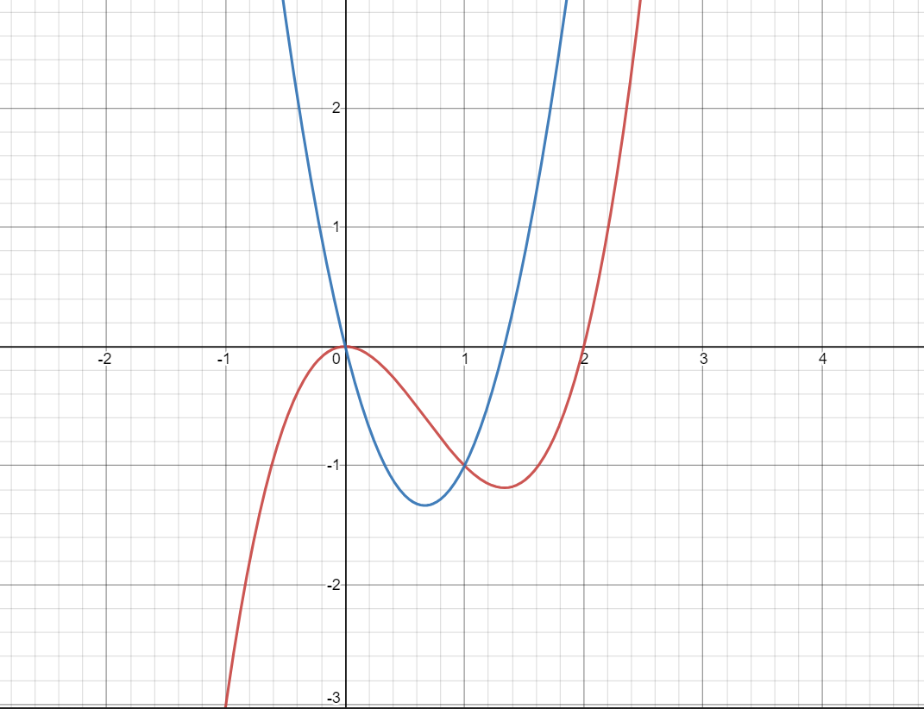
Quiz time:
f’(x)
f(x)
Find f(x) and f’(x) and f’’(x) if present.
When we have a saddle point
Velocity has to be = 0.
Derivative of a polynomial will be one order lower.

Slide 12
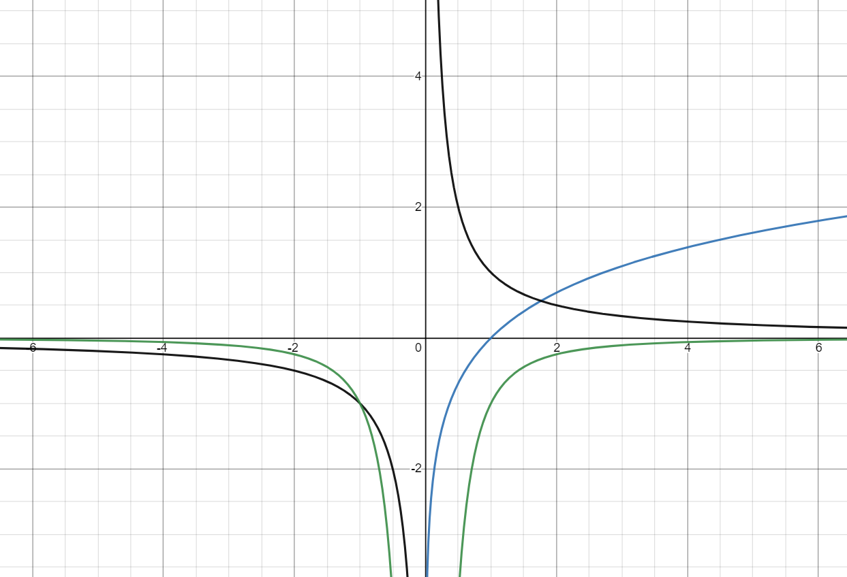
Quiz time:
f’(x)
Find f(x) and f’(x) and f’’(x) if present.
We can look for convergences.
We see that as f(x) converges to its limit f’(x) should approximate 0.
Same for f’’(x) with respect to f(x).
f(x)
f’’(x)

Slide 13
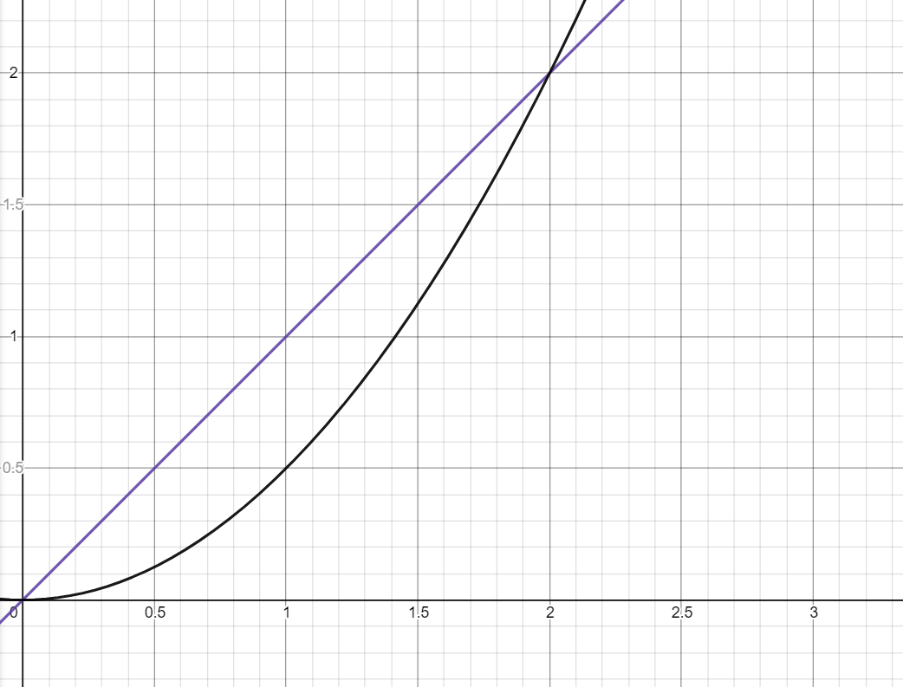

Quiz about integrals.
- Find f(x) and F(x).
What is the relationship between f(x) and F(x)?
Both geometrically and more formally.
f(x) = x
F(X) = $\frac{1}{2}x^{2}$
- F’(X) = x
F(X)
f(x)

Slide 14
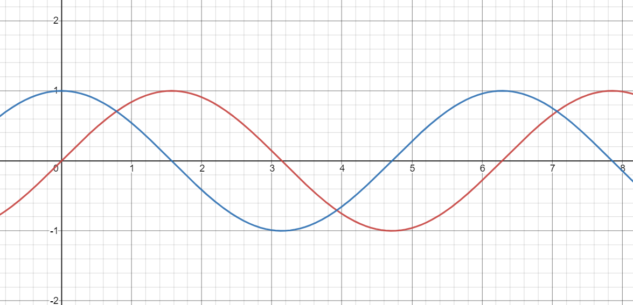
A tricky one.
- Find f(x) and F(x).
Why does F(X) go into the negative?
Is integrals “areas”?
Remember what happened to the determinant when we flipped it?
If we want the total area?
- Split up the integrals.
f(x)
F(x)

Slide 15
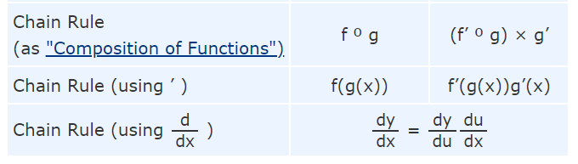

“advanced integration/derivatives”
Chain Rule:
The derivative of nested function can be found using the above formula.
Example:
$f\left(x\right)= \ln\left(x^{2}+10\right) f^{′}\left(x\right)=\frac{1}{x^{2}+10 }∗2x$

Slide 16
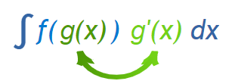
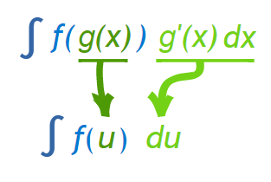

“advanced integration/derivatives”
Integration by substitution: (Reverse Chain Rule)
Integration as an anti-derivative .
$f^{′}\left(x\right)=\frac{1}{x^{2}+10 }∗2x$ , F’(X) =$\ln\left(x^{2}+10\right)+C$ , f(x) = $\ln\left(x^{2}+10\right)$
But how do we operationalize it?
Integration by substitution doesn’t work on everything. However,…
Our above expressions lives up to the formula.
Therefore.
Let’s see an example.

Slide 17

“advanced integration/derivatives”
Integration by substitution: (Reverse Chain Rule)
$f^{′}\left(x\right)=\frac{1}{x^{2}+10 }∗2x$ , F’(X) =$\ln\left(x^{2}+10\right)+C$
But how do we operationalize it?
$g\left(x\right)=x^{2}+10=u , g^{′}\left(x\right)=2x=du$
$\int{\frac{1}{u}du}=\ln\left(u\right)+c$ (replace with u and du and integrate)
$F^{′}\left(x\right)= ln⁡(x^{2}+10)$ + c (Replace u)
The trick is to be able to rewrite it into the write form.

Slide 18
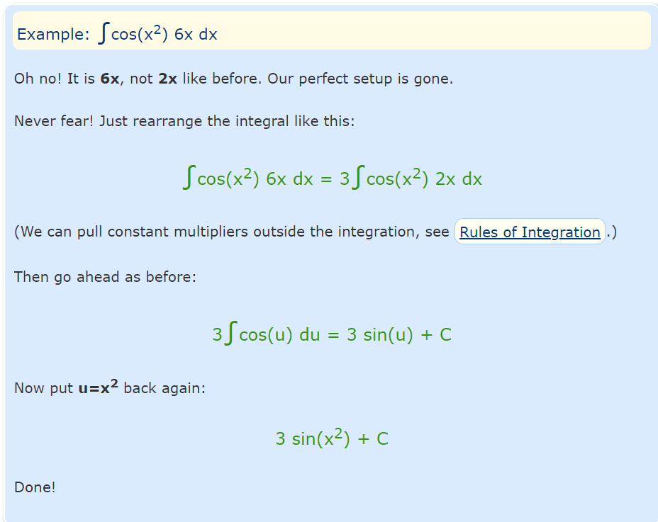
If it doesn’t fit.

Slide 19
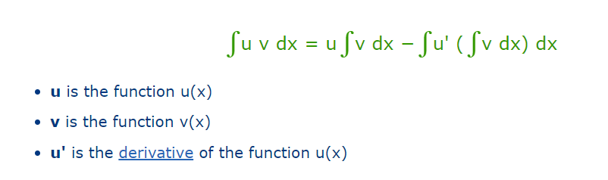
Integration by Parts
Integration by Parts is a special method of integration that is often useful when two functions are multiplied together but is also helpful in other ways.
We need to select u and v.
Select the u which derivative can simplify the expression.

Slide 20
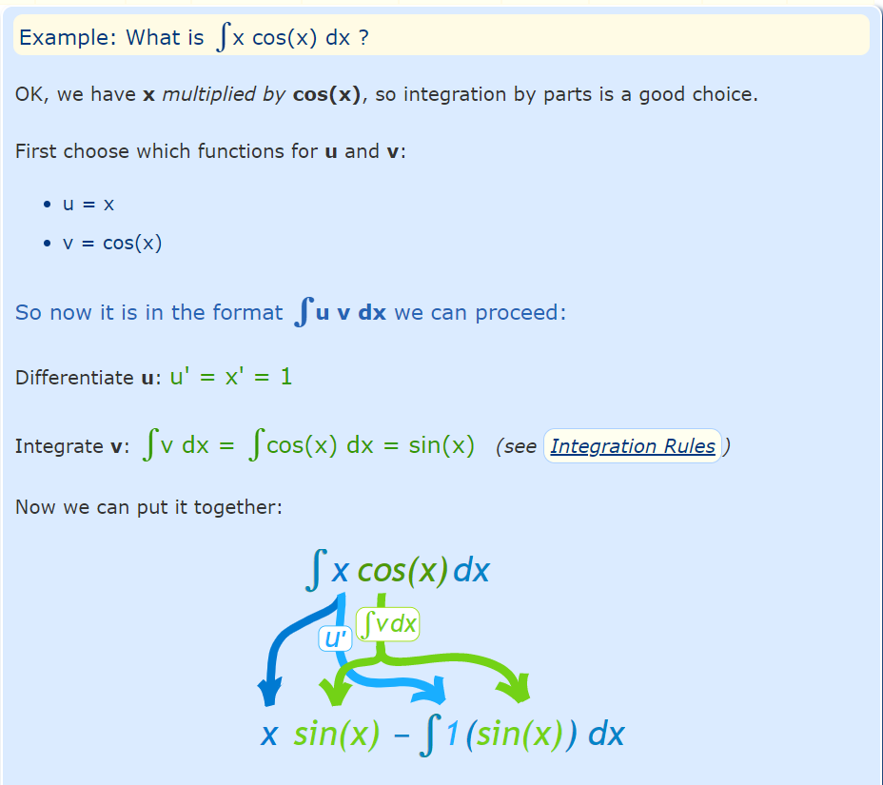
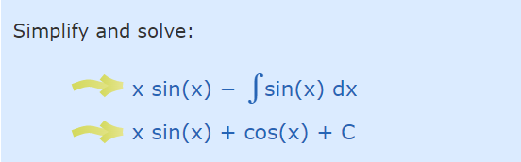
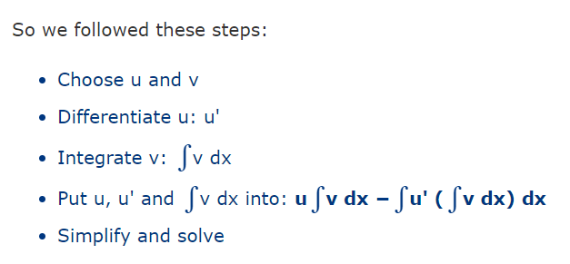
Integration by parts examples:
Step by step:

Slide 21

Limits
If you have questions about:
Limits
Intervals
+/- infinity
L’Hospital
Come to me and I’ll help you.

Slide 22

Let’s get going!
Exercises:
5.1 5.2 5.3 5.5
5.7 5.8 5.10 5.11
Hint for 5.11:
Is the parabolla happy or sad?
Find roots
Maybe split integrals.

